Slide 1
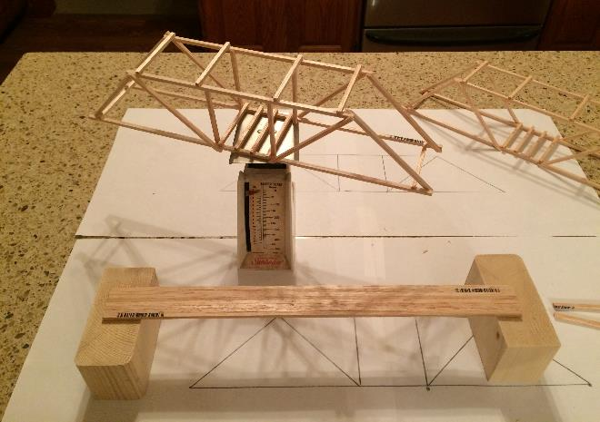
Statics
Balsa Wood Bridge Analysis and Testing
LabRat Scientific
© 2018

Slide 2
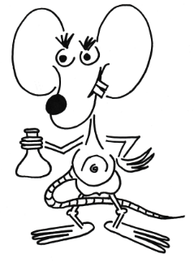
This lesson is intended to be used in conjunction with the “Method of Joints” Classroom Lesson and the companion LabRat bridge test experiment video.

Slide 3
Bridge Analysis and Load Test
A simple dual-truss bridge will be built out of square balsa wood sticks and will be loaded to failure. A sample “Method of Joints” analysis will be completed for the loading case below:
90⁰
90⁰
45⁰
45⁰
45⁰
45⁰
2.0 Lbs
11 inches

Slide 4
The following sign conventions and nomenclature will be used in the analyses.

Slide 5
Method of Joints – Force Sign Convention
Y
Positive Y-Force Direction ( + F)
Positive X-Force Direction ( + F )
Negative X-Force Direction ( - F )
Negative Y-Force Direction ( - F)
X
Recall: Forces are “vectors” and this show magnitude and direction.

Slide 6
Force Notation - Examples
Negative Direction
F_{BD}
D
E
B
Positive Direction
Negative Direction
F_{AB}
A
F_{AC}
C
F
Positive Direction
The analyses will involve force variables and using this notation can help avoid confusion.

Slide 7
Method of Joints – Compression and Tension Convention
If the Force Vector is pointing towards the pin joint, then the member is in Compression.
If the Force Vector is pointing away from the pin joint, then the member is in Tension.

Slide 8
Trigonometry Review
Forces will be assessed in the horizontal and vertical axes. As such, forces along a diagonal member will have to the broken down into their horizontal and vertical components.
Hyp
Opp = Hyp * Sin ϴ₂
Sin ϴ = Opp / Hyp
Cos ϴ = Adj / Hyp
Tan ϴ = Opp / Adj
90⁰
ϴ₂
Opp² + Adj² = Hyp²
Adj = Hyp * Cos ϴ₂

Slide 9
Generally speaking, truss problems are “static” in nature, which means nothing is moving. Under these circumstances any summed forces in the X-direction or Y-direction must add up to zero (no net force).
∑ F_{y} = 0
∑ F_{x} = 0
If there are no net forces acting on any point, Newton says that point will not experience any changes in its motion. Since we assume the points are initially at rest, this means the points will remain at rest…

Slide 10
System Free Body Diagram (FBD)
The first step is to determine the FBD for the entire system to identify reactive forces.
D
E
B
A
C
F
1.0 Lb
1.0 Lb
1.0 Lb
1.0 Lb
Resulting Supporting Force
Load
Resulting Supporting Force

Slide 11
D
E
B
A
C
F
1.0 Lb
1.0 Lb
1.0 Lb
1.0 Lb
Resulting Supporting Force
Load
Resulting Supporting Force
In this system FBD the upward forces are equal and opposite the downward forces. This means the system is in static equilibrium.

Slide 12
We begin the Method of Joints analysis by selecting a joint (point) to start with. A Free Body Diagram for that point is developed and then the forces are analyzed.
You need to start with a joint that has at least one force defined.

Slide 13
B
Free Body Diagram (FBD) of Point A on the bridge structure:
A
F_{AB}
C
1.0 Lb
1.0 Lb
1.0 Lb
1.0 Lb
45⁰
45⁰
We want to calculate the forces in the two truss members that are joined at Point A. These forces are defined as F_{AB} and F_{AC} .
F_{AC}
A
1.0 Lb
To do this, we set the sum the forces in the X-direction equal to zero and set the sum of the forces in the Y-direction to zero…

Slide 14
Analysis of Point A
F_{AB}
The 1.0 lb supporting force is known from the system FBD.
45⁰
- F_{AB} * Sin (45)
45⁰
Sum the Forces in the Y-direction ( ∑ F_{y} ):
45⁰
45⁰
∑ F_{y} = ( + 1.0 ) + ( - F_{AB} * Sin (45) ) = 0
A
∑ F_{y} = ( + 1.0 ) + ( - F_{AB} * 0.707 ) = 0
+ 1.0 = F_{AB} * 0.707
1.0 Lb
F_{AB} = + 1.0 / 0.707
F_{AB} = 1.41 lbs
The direction of the F_{AB} force vector was assumed. Since the mathematics generated a positive (+) F_{AB} the assumed direction was correct. Had the result been negative we would have had to reverse the direction of the F_{AB} arrow…

Slide 15
Analysis of Point A
F_{AB}
Now we need to assess the horizontal (X-direction) forces:
45⁰
Sum the Forces in the X-direction ( ∑ F_{X} )
45⁰
∑ F_{x} = ( - F_{AC} ) + ( - F_{AB} * Sin (45) ) = 0
F_{AC}
A
∑ F_{x} = (- F_{AC} ) + ( - F_{AB} * 0.707 ) = 0
- F_{AB} * Sin (45)
+ F_{AC} = - F_{AB} * 0.707
+ F_{AC} = - 1.41 * 0.707
F_{AC} = - 1.0 lbs
Since the sign for F_{AC} is negative (-1.0 lbs), the assumed direction for F_{AC} was incorrect. As such the force arrow for F_{AC} in the diagram above needs to be flipped…

Slide 16
Analysis of Point A
F_{AB}
Now we need to assess the horizontal (X-direction) forces:
45⁰
Sum the Forces in the X-direction ( ∑ F_{X} )
45⁰
∑ F_{x} = ( - F_{AC} ) + ( - F_{AB} * Sin (45) ) = 0
F_{AC}
A
∑ F_{x} = (- F_{AC} ) + ( - F_{AB} * 0.707 ) = 0
- F_{AB} * Sin (45)
+ F_{AC} = - F_{AB} * 0.707
+ F_{AC} = - 1.41 * 0.707
F_{AC} = - 1.0 lbs
Since the sign for F_{AC} is negative (-1.0 lbs), the assumed direction for F_{AC} was incorrect. As such the force arrow for F_{AC} in the diagram above needs to be flipped…

Slide 17
Analysis of Point A
This is the force in Member AB. The direction of the arrow indicates this beam is in compression.
F_{AB} = 1.41 lb
A
F_{AC} = 1.0 lb
This is the force in Member AC. The direction of the arrow indicates this beam is in tension.
1.0 Lb
A member in compression could start to bend and eventually buckle if it is not strong enough to resist the force. This is a failure mode to look for during testing…

Slide 18
B
D
Free Body Diagram (FBD) of Point B on the bridge structure:
A
C
B
F_{BD}
1.0 Lb
1.0 Lb
1.0 Lb
1.0 Lb
45⁰
F_{AB} = 1.41 lb
45⁰
We want to calculate the forces in the three truss members that are joined at Point B. We already calculated one of the forces (F_{AB}). The other two forces are defined as F_{BC} and F_{BD} .
45⁰
F_{BC}
Once again we sum the forces…

Slide 19
Analysis of Point B
B
Knowing F_{AB} the other forces on Point B can be determined by once again summing forces.
45⁰
F_{AB} = 1.41 lb
45⁰
F_{BC} * Sin (45)
Sum the Forces in the Y-direction ( ∑ F_{y} ):
45⁰
F_{AB} * Sin (45)
∑ F_{y} = ( + F_{AB} * Sin (45) ) + ( + F_{BC} * Sin (45) ) = 0
F_{BC}
∑ F_{y} = ( + 1.41 * Sin (45) ) + ( + F_{BC} * Sin (45) ) = 0
∑ F_{y} = ( + 1.0 ) + ( + F_{BC} * 0.707 ) = 0
F_{BC} * 0.707 = - 1.0
F_{BC} = - 1.41 lbs
The negative sign indicates the assumed direction for the force in F_{BC} is incorrect. The force arrow for F_{BC} in the diagram above needs to be flipped…

Slide 20
Analysis of Point B
B
Knowing F_{AB} the other forces on Point B can be determined by once again summing forces.
45⁰
F_{AB} = 1.41 lb
45⁰
F_{BC} * Sin (45)
Sum the Forces in the Y-direction ( ∑ F_{y} ):
45⁰
F_{AB} * Sin (45)
∑ F_{y} = ( + F_{AB} * Sin (45) ) + ( + F_{BC} * Sin (45) ) = 0
F_{BC}
∑ F_{y} = ( + 1.41 * Sin (45) ) + ( + F_{BC} * Sin (45) ) = 0
∑ F_{y} = ( + 1.0 ) + ( + F_{BC} * 0.707 ) = 0
F_{BC} * 0.707 = - 1.0
F_{BC} = - 1.41 lbs
The negative sign indicates the assumed direction for the force in F_{BC} is incorrect. The force arrow for F_{BC} in the diagram above needs to be flipped…

Slide 21
Analysis of Point B
B
Now the X-direction forces are summed. Notice that this equation involves three forces.
F_{BD}
45⁰
F_{AB} = 1.41 lb
45⁰
45⁰
F_{BC}
F_{AB} * Sin (45)
F_{BC} * Sin (45)
Sum the Forces in the X-direction ( ∑ F_{x} ):
∑ F_{x} = ( + F_{AB} * Sin (45) ) + ( - F_{BC} * Sin (45) ) + ( - F_{BD} ) = 0
∑ F_{x} = ( + 1.41 * Sin (45) ) + ( - 1.41 * Sin (45) ) + ( - F_{BD} ) = 0
∑ F_{x} = ( + 1.0 ) + ( - 1.0 ) + ( - F_{BD} ) = 0
This is an interesting result. Beam BD is not off-setting any forces in the structure…
F_{BD} = 0

Slide 22
Analysis of Point B
B
F_{BD} = 0
45⁰
F_{AB} = 1.41 lb
45⁰
F_{BC} = 1.41 lb
The analysis indicates that Beam BC is providing the necessary X-direction and Y-direction balancing forces required for static equilibrium.

Slide 23
B
D
Free Body Diagram (FBD) of Point C on the bridge structure:
A
C
F
F_{BC} = 1.41 lb
F_{CD}
1.0 Lb
1.0 Lb
1.0 Lb
1.0 Lb
45⁰
45⁰
C
There are several members joined at Point C. We already know the forces in two of the members and we know there is an external force (-1.0 lb).
F_{AC} = 1.0 lb
F_{CF}
We sum forces once again to calculate the unknown forces F_{CD} and F_{CF} …
1.0 Lb

Slide 24
Analysis of Point C
F_{BC} = 1.41 lb
Several of the forces acting on Point C are known from the previous calculations. Once again we sum the forces…
45⁰
F_{AC} = 1.0 lb
C
45⁰
F_{CF}
- F_{BC} * Sin (45)
Sum the Forces in the X-direction ( ∑ F_{x} ):
∑ F_{x} = ( - F_{BC} * Sin (45) ) + ( + F_{AC} ) + ( - F_{CF} ) = 0
∑ F_{x} = ( - 1.41 * Sin (45) ) + ( + 1.0 ) + ( - F_{CF} ) = 0
∑ F_{x} = ( - 1.0 ) + ( + 1.0 ) + ( - F_{CF} ) = 0
F_{CF} = 0

Slide 25
Analysis of Point C
F_{BC} = 1.41 lb
F_{CD}
45⁰
F_{BC} * Sin (45)
C
45⁰
Sum the Forces in the Y-direction ( ∑ F_{y} ):
1.0 Lb
∑ F_{y} = ( + F_{BC} * Sin (45) ) + ( - 1.0 ) + ( + F_{CD} ) = 0
∑ F_{y} = ( + 1.41 * Sin (45) ) + ( - 1.0 ) + ( + F_{CD}) = 0
∑ F_{y} = ( + 1.0 ) + ( - 1.0 ) + ( + F_{CD} ) = 0
F_{CD} = 0

Slide 26
Forces in the Members of the Test Bridge
F_{BD} = 0
D
E
B
F_{AB} = 1.41 lbs
Compression
F_{CB} = 1.41 lbs
F_{CD} = 0
Tension
A
F_{AC} = 1.0 lbs
C
F_{CF} = 0
F
Tension
These are the forces in the members when a 2.0 lb load is placed on top of Member CF. All of the member forces will increase as the load is increased. An analysis of the right-hand side of the truss will yield the same results.

Slide 27
F_{BD} = 0
D
E
B
F_{AB} = 1.41 lbs
Compression
F_{CB} = 1.41 lbs
F_{CD} = 0
Tension
A
F_{AC} = 1.0 lbs
C
F_{CF} = 0
F
Tension
The analysis seems to indicate that Member CD and Member EF could be removed without reducing the strength of the truss. This can be tested…
This is not the case for Member BD and member CF since they are critical to the rigidity of the truss – even though they carry no loads…

Slide 28
Bridge models can be built and tested to see if the vertical zero-force members have an effect on the strength of the structure.

Slide 29
Experimental Test Bridges
Bridge A (Plank)
Bridge B
Bridge C

Slide 30
Materials
1/8” square balsa wood sticks (36” long)
White Glue
Hobby Knife (sharp)
Paper (for making templates)
Vertical supports (2x4 segments to ensure trusses are parallel when joined
Load Test Rig (see side) – buckets, small tables, boxes could be used
Load Beam (2x2 segment or similar)
Load container
String
Load (sand, rocks, other…)
Scale (to measure the weigh of the load when bridge fails)

Slide 31
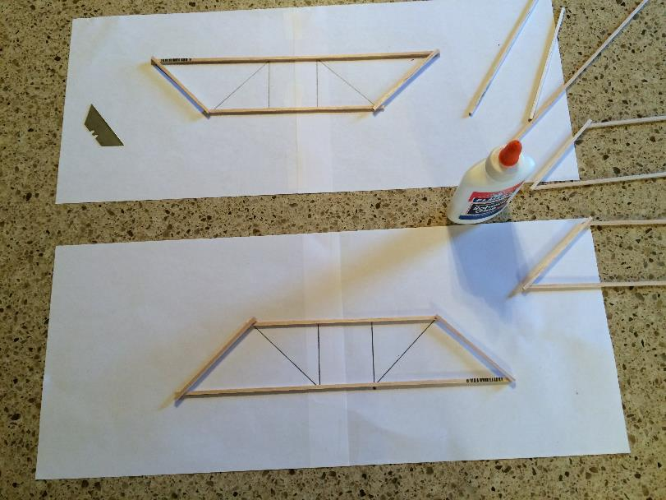
Bridge Construction
Paper templates were made to help ensure the trusses were constructed (nearly) identical.
The outer members were assembled first and allowed to dry.

Slide 32
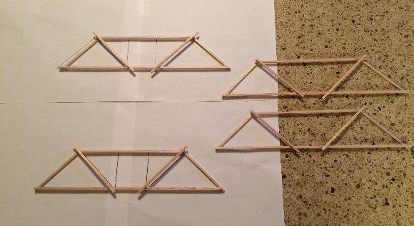
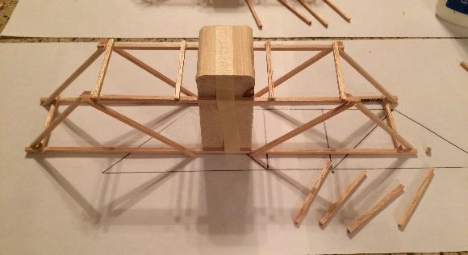
Bridge Construction
Once the glue had dried, the internal diagonal members were added.
The two trusses had dried, the were attached to a vertical support so that cross members could be added to join the trusses together. It is important that the two trusses are vertical.

Slide 33
Bridge Construction
One bridge was built without the vertical members at the center.
One bridge was built with the vertical members at the center.

Slide 34
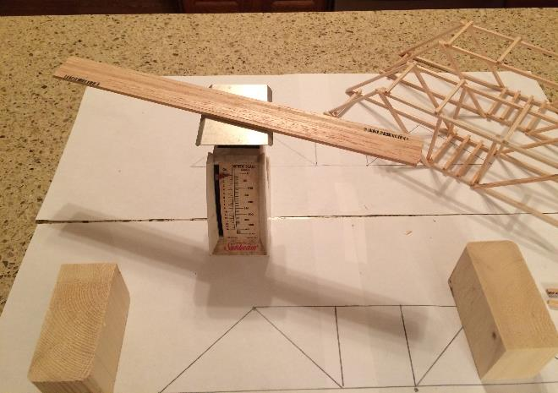
Bridge Construction
For the experiment, all of the trusses need to contain the same amount of material so a 1 to 1 comparison can be made. The two truss bridges were nearly identical in weight.
A flat plank bridge was built to demonstrate the value of the truss configuration. Sticks were used to make the plank. The number of sticks was dictated by the needed weight of the bridge.

Slide 35
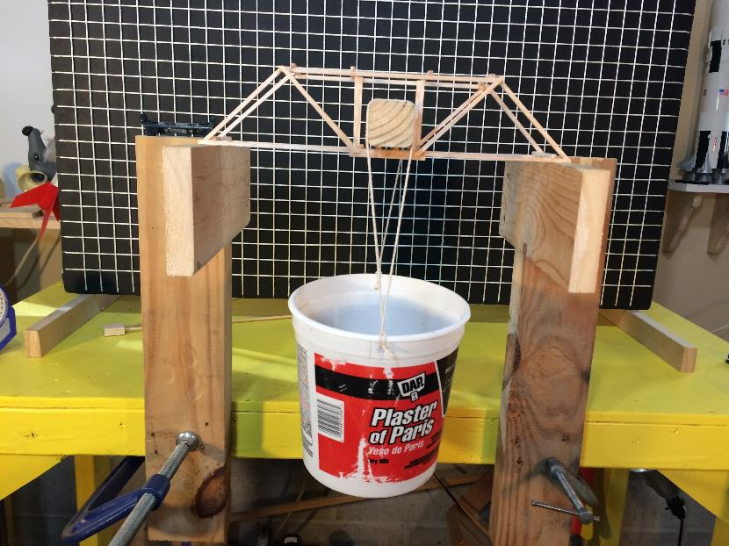
Load Test Rig
A load stand was created so the bridges could be tested in a controlled manner.
Small rocks were placed in the container to apply the load to the bridge. The bridges were tested to failure.
The container was hanging from a stiff 2x2 wood bar in an attempt to make sure no asymmetrical loads are applied to the bridges.

Slide 36
Hypotheses
H1 - The plank bridge should fail under the smallest load since it does
not take advantage of the truss structure.
H2 - The two truss bridges should fail at nearly the same load since the
center vertical members were determined to carry no load.

Slide 37
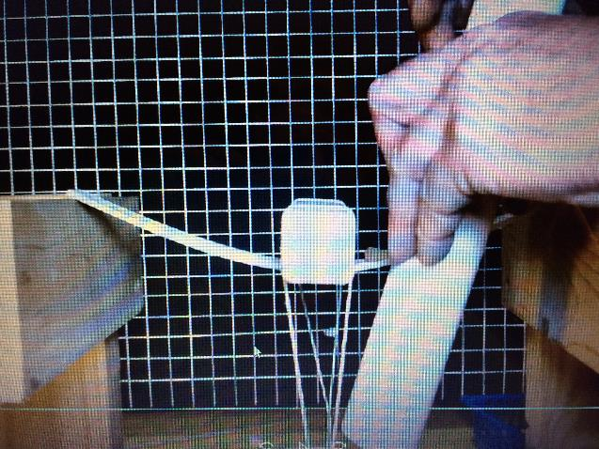
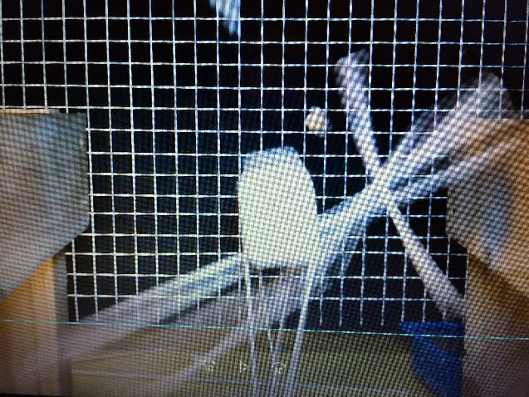
Bridge-A (Plank) underwent a significant amount of bending before it failed.
The load at failure was 8.0 lbs

Slide 38
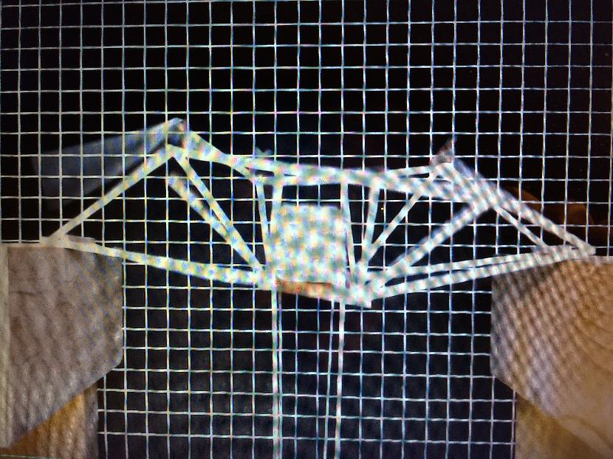
Bridge-B (Truss w/ vertical members) was very stiff and flexed very little upto the point of failure.
The load at failure was 12.6 lbs

Slide 39
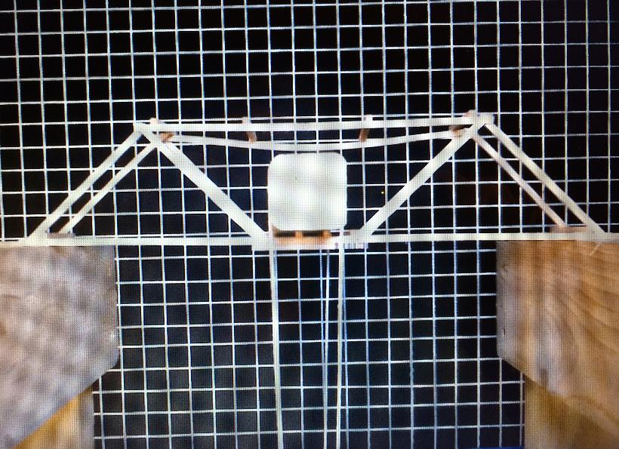
Bridge-C (Truss w/o vertical members) was not as stiff as Bridge-B. In this image it is apparent that the rear, upper horizontal member had developed a significant bow just prior to failure.
The load at failure was 10.6 lbs

Slide 40
Bridge | Bridge Weight (lb) | Failure Load (lb) | Structural Ratio (load/weight)
A - Plank | 0.02 | 8.0 | 400
B - Truss w/ Vertical Members | 0.02 | 12.6 | 630
C - Truss w/o Vertical Members | 0.02 | 10.6 | 530
The bridge with the vertical members was the strongest and most efficient structure.

Slide 41
Hypothesis 1
Proven to be CORRECT.
The truss structures could carry more load and thus were the more efficient structures.

Slide 42
Hypothesis 2
Proven to be INCORRECT.
The analysis is for a “perfect” structure where all angles are precise, the structure remains perfectly vertical, all joints have the same strength, and all members have the same strength. The actual models were not “perfect”.
As indicated in the summary of member loads, it was suggested that the zero-load members were necessary for structural integrity. As the bridges were loaded, small initial asymmetries caused off-ideal alignments and loading which ultimately caused the zero-load members to become loaded. The vertical members in Bridge-B kept the top horizontal members from flexing and allowed the structure to hold more load.

Slide 43
Conclusions
A truss structure will carry more load than a simple plank structure of the same weight and material.
Truss structures tend to be stiff and can fail with little warning.
In general, zero-load members are important to the structural integrity of a truss structure and thus should not be removed from the design.
Theoretical analyses are only as good as the assumptions made. The assumption that the actual structure will be ideal is not a sound assumption.
Actual structures, no matter how carefully they are built, are not going to be “perfect”.

